Slide 1
CustomerPro
Introduction
Levi Garner and Siyu Miao
Introduction
Timeline of our Project
What is CustomerPro/Why this concept is important?
How it works & Current Database
CustomerPro in IOS
Demo
Questions

Slide 2
CustomerPro
TimeLine
How important was design in our project? (Wireframes, Methods & Database Design)
What would we have done differently? (Technology Feasibility)
Considerations regarding Timeline & where we are at now
Formed Group
9/23/2015
Tabbed App Due & Printciple Table View
Views / Persistent Storage
11/23/2015
Fall-Symposium
12/17/2015
10/10/2015
UML Document Due
11/5/2015

Slide 3
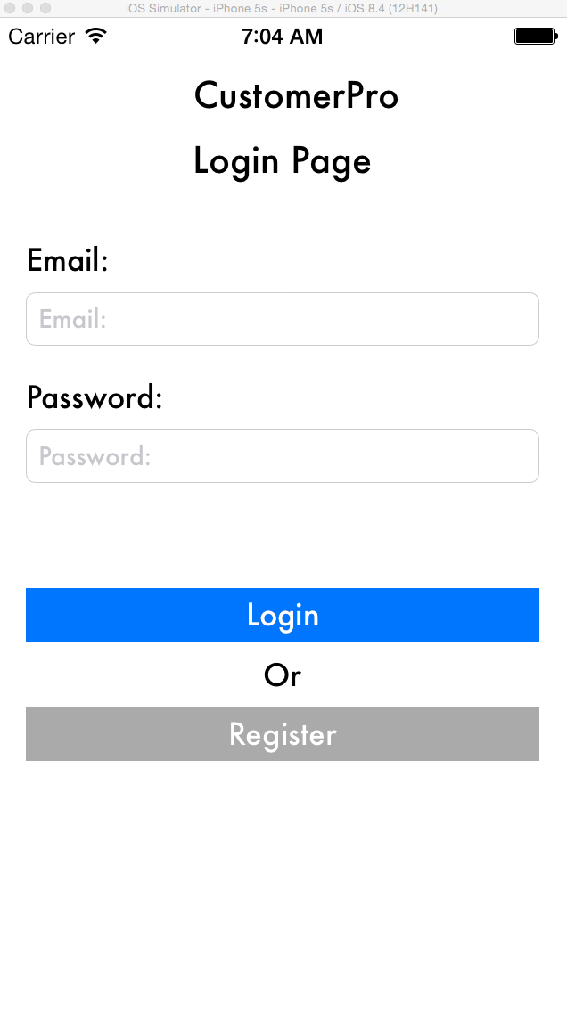
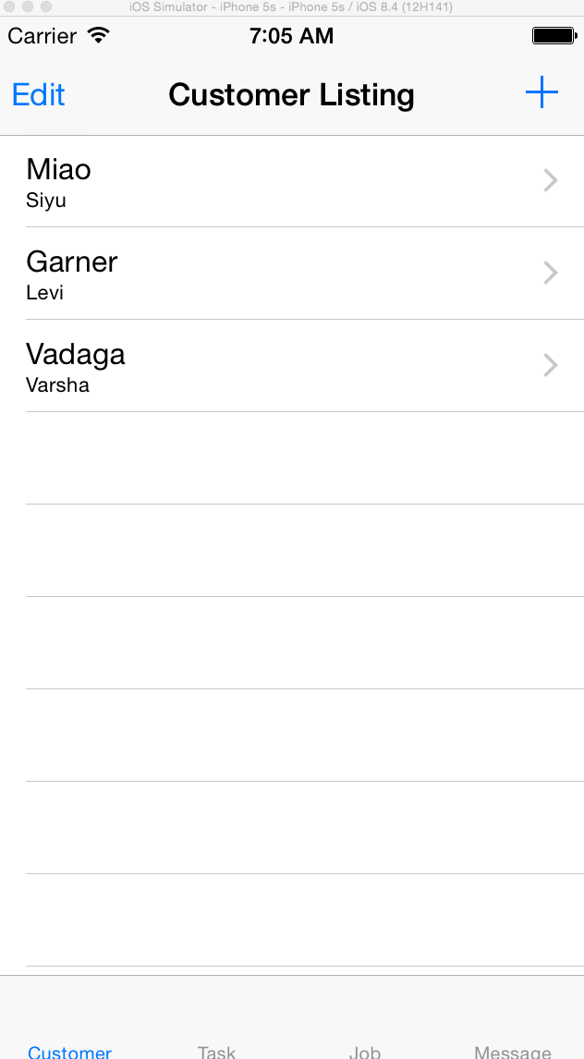
CustomerPro
What is CustomerPro?
What is Customer Pro/Why this concept is important?
Customer Pro is a free IOS app, that manages service businesses customers, messages & Jobs
Why this concept is important?
Smaller service based startups don’t have the money for premium software: CustomerPro is a free and affective alternative.
Most service business are on the go! So, a mobile solution correlates with the lifestyle demanded . For example, Cleaning Services, Plumbers

Slide 4
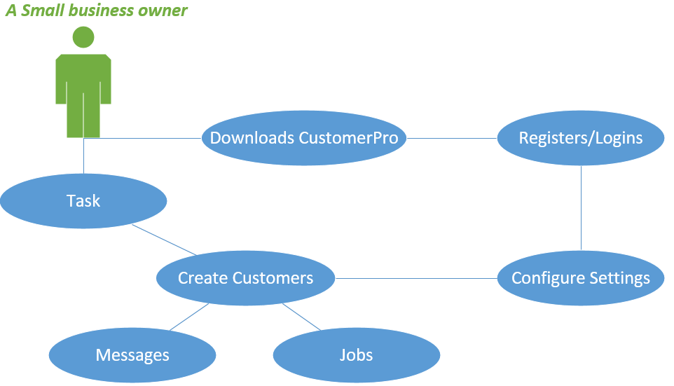
CustomerPro How it works

Slide 5
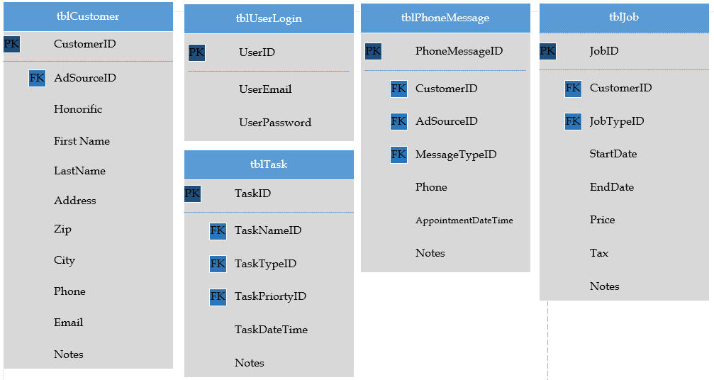
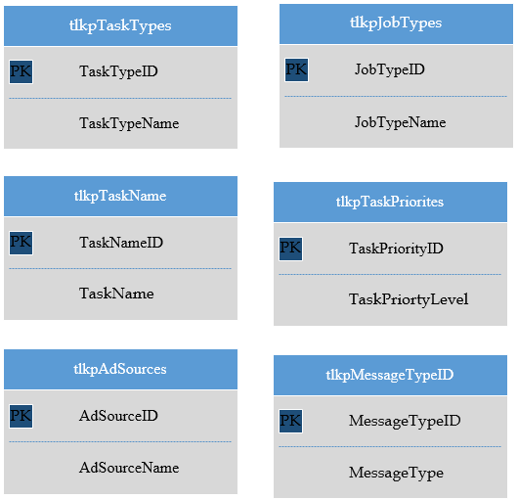
CustomerPro
Database
Primary Tables
Lookup Tables

Slide 6
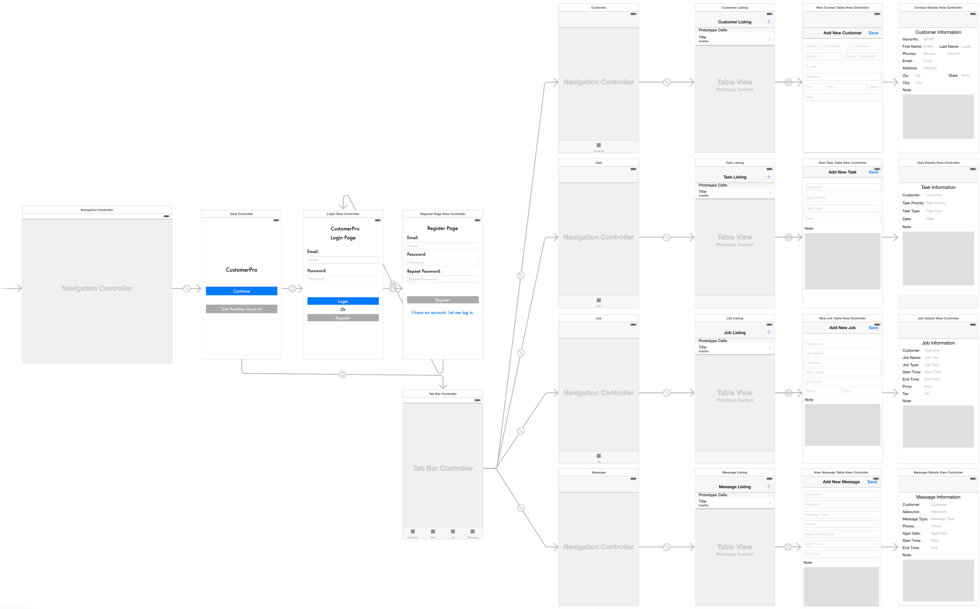
CustomerPro
CustomerPro In IOS

Slide 7
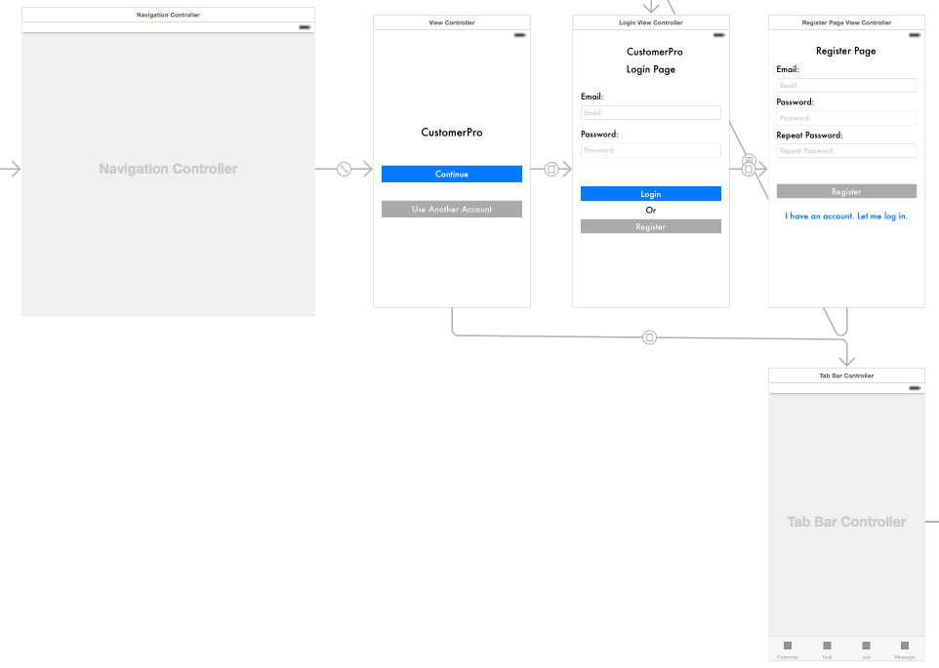
CustomerPro
CustomerPro In IOS

